Slide 1
SMART SOLAR GRASS CUTTER BY ACHAL KALWAR ROHAN MATHUR SHUBHAM CHAVAN UNDER THE GUIDANCE OF PROF. MEENA UGALE

Slide 2
PROBLEM DEFINITION
The problems with available grass cutter robots are as follows:
Power consumption.
Human effort.
Time consumption.
Safety.
Noise pollution and air pollution.
Maintenance.
Cord type of electric grass motor is problematic and dangerous.
Inconvenient.

Slide 3
AIMS AND OBJECTIVES
To reduce power consumption and time consumption.
To reduce human effort.
To reduce noise and air pollution.
To come up with a cutter that is portable, durable, easy to operate and maintain.
To design a self- powered cordless solar grass cutter.
To implement agricultural automation.
To enhance safety.

Slide 4
SCOPE OF THE PROJECT

Slide 5
FEATURES OF THE PROJECT
Easy to move from one place to another place.
Compact size and portable.
Operating principle is simple.
Non-skilled person also can operate this machine.

Slide 6
HARDWARE AND SOFTWARE REQUIREMENTS
Arduino Mega Board - 1.
Ultrasonic Sensor - 1.
Solar Panel.
L298N Motor Driver - 1.
DC Motors - 5.
Battery - 2.
Wheels - 4
Grass cutter blade - 2
Arduino compiler.
C programming language.

Slide 7
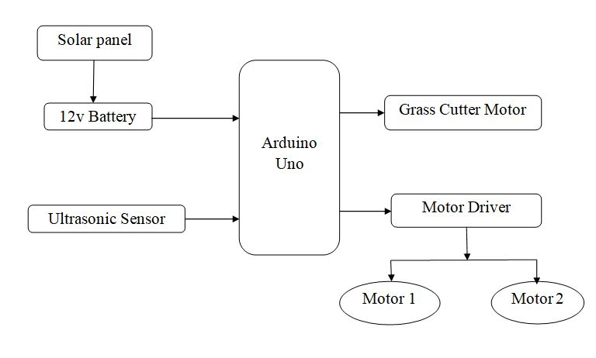
BLOCK DIAGRAM
Mega

Slide 8
12V Battery
Arduino Mega
Grass Cutter Motor
SPST Rocker Switch
Motor Driver
(L298N)
Ultrasonic Sensor
Motor 1
Motor 2

Slide 9
SPST Rocker switch
No
Yes
Battery
Arduino Mega
Motor Driver
Motors with wheels and cutter
Ultrasonic Sensor
Yes
Obstacle?
Rotate
No
Move forward
Stop

Slide 10
REFERENCES
Neha, Syeda Asra- Automated Grass Cutter Robot Based on IoT, IJTSRD, Volume -2 Issue – 5, Jul-Aug 2018 accessed on 11th July 2019, 9:35 AM.
Prof.S.M.Patil, Bhandirge Prajakta, Kumbhar Snehal, Patil Dhanashri-Smart Solar Grass Cutter With Lawn Coverage, IRJET, Volume: 05 Issue: 03 , Mar-2018 accessed on 18th July 2019, 9:50 AM.
Shekhar Kumar, Anshika Sharma, Rishabh Sharma, Shubham Kesarwani -A Review Paper on Grass Cutter Device Using Bluetooth, Journal of Electronics and Electromagnetic Technology, Volume-1 Issue-1, 2018 on 25th July 2019, 10:15 AM.
https://nevonprojects.com/fully-automated-solar-grass-cutter/ accessed on 1st August 2019, 9:38 AM.

